Slide 1
Preprocessing for Handwriting Recognition
東北大学大学院工学研究科
電子工学専攻川又研究室
Perttu Pitkänen

Slide 2
Overview
Introduction
Handwriting recognition
Preprocessing

Slide 3
Introduction
Handwriting recognition (HWR) is the process of extracting text in digital form from handwritten images or input devices.
Matlab used for implementation.
IAM handwriting database provides wide variety of different handwriting styles in English.
This phase of research concentrates on preprocessing.

Slide 4
Handwriting recognition
Used methods for handwriting recognition include Optical Character Recognition (OCR) or Intelligent Word Recognition (IWR).
OCR is used to recognize individual characters while IWR recognizes whole words.
Recognition process can be divided into three main phases:
Preprocessing
Feature extraction
Classification

Slide 5
Handwriting recognition
Each phase reduces the amount of data to be processed.
Preprocessing
Includes noise removal, binarization and segmentation.
Image is enhanced for feature extraction phase and the deteted objects are extracted.
Feature Extraction
Shape describing features are extracted from previously acquired objects.
Histogram of ordered gradients, horizontal and vertical histograms, topological features (loops, junctions)

Slide 6
Handwriting recognition
Classification
Extracted features are used in machine learning algorithms to create the feature vector.
The inputs are classified according to this vector.
For example simple k-means clustering can be applied to find the correct category for the input. In this case the feature vector can be constructed from previously mentioned features or their combinations.
For this research the chosen research subjects are the preprocessing and feature extraction phases.

Slide 7
Preprocessing 1
During this research following preprocessing features were considered:
Image aquisition
Noise removal
Binarization
Object filtering
Object extraction

Slide 8
Preprocessing 2
Image is converted to grayscale
Noise is removed using 3x3 adaptive wiener filter
Adapts to the variation. More smoothing if variance is large.
3x3 neighbourhood optimal for most cases. Larger filter sizes resulted in exessive blur.
Histogram equalization is not applied because in most cases it increased the visibility of irrelevant objects such as paper texture.

Slide 9
Preprocessing 3 (Binarization)
Binarization is important part of the preprocessing
Image may have uneven lighting resulting in visible shadows or gloss.
Sauvola algorithm was designed for documant binarization purpose

Slide 10
Sauvola algorithm
Uses adaptive thresholding to binarize document images with uneven lightning or texture
Enhanced version of Nilback binarization algorithm
Can apply different algorithms to textual and non-textual areas of the image
1) Textual components
Histogram based method
Threshold control:
-Threshold decisions
- Interpolative adjustment
Hybrid switch:
Region type:
1)Text
2)Background
Gray-scale
document image
Bi-level
image
2) Non-textual components
Soft decision based method

Slide 11
Sauvola algorithm
One MATLAB implementation of Sauvola algorithm woks as follows
BW = SAUVOLA(IMAGE, [M N], THRESHOLD, PADDING)
IMAGE = image file
[M N] = MxN neighbourhood
THRESHOLD = Nilback threshold, “sensitivity”
PADDING = method to handle border pixels e.g. ‘replicate’

Slide 12
NICK algorithm
todo

Slide 13
図形のデフォルト設定
ブロック（四角）や線（矢印）の線の太さは2ptとする
このデザインテンプレートでは，ブロックは塗りつぶしなしで，線の太さは2ptになるようにしている．
例：
矢印については，終点のスタイルを右上のタイプとし，サイズを右下の一番大きいものとしておく．
例：

Slide 14
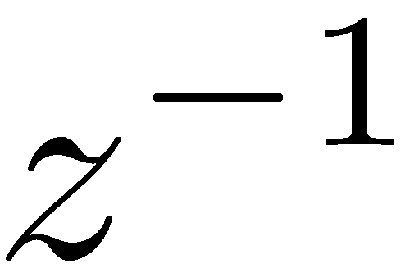

ディジタルフィルタの基本要素
$$z^{−1}$$
TeXpoint版
数式ツール版

Slide 15
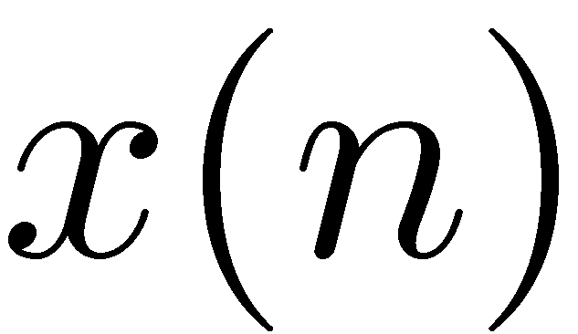
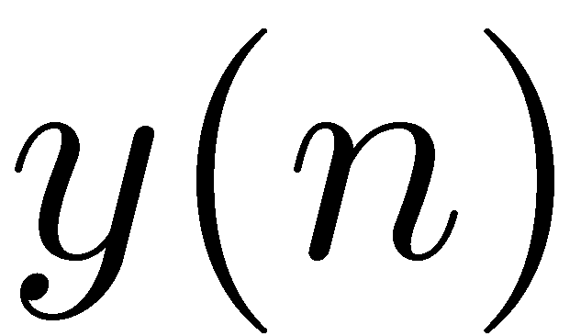
ディジタルフィルタの基本要素の接続
ブロック間はオートシェープのコネクタを使用して接続する．
コネクタが若干傾く場合は，ブロックを上下左右に移動させると，
どちらかの方向からか移動させた場合に傾きが取れる．

Slide 16




ディジタルフィルタの基本要素の接続（数式ツール版）
$$x\left(n\right)$$
$$z^{−1}$$
$$z^{−1}$$
$$y\left(n\right)$$
ブロック間はオートシェープのコネクタを使用して接続する．
コネクタが若干傾く場合は，ブロックを上下左右に移動させると，
どちらかの方向からか移動させた場合に傾きが取れる．

Slide 17
ブロック内の文字
ブロック内にはこのように
文字が入力できる

Slide 18
MATLAB用標準カラーマップ
MATLAB 2015aからは，グラフなどに使用するカラーマップが新しくなりました．この新しい色を参考までに以下に用意しました．これらの色は，プロジェクタなどに表示した際にも見やすい色になっています．（従来の色は明るすぎて見にくい場合がありました．）

